Slide 1


Welcome to English for Programming
Week 1 Class 2
Programmers made by StorySet> <a href="https://storyset.com/web">Illustration by Freepik Storyset</a>

Slide 2

Topics for today
By the end of the class, you will be able to…
Share your experiences from the previous Asynchronous Session
Identify and use the verb to be in simple tense (negatives and questions)
Learn about countries and nationalities
Talk about IT jobs
Pronounce and identify word stress in countries, nationalities and IT related words

Slide 3

Tutorial – Review
What did you learn in the asynchronous session?
What did you find interesting?
Are there questions regarding your individual work?
My favorite NO: Learning from mistakes
Calendar Flat Illustrations made by Storyset: https://storyset.com/illustration/calendar/rafiki

Slide 4
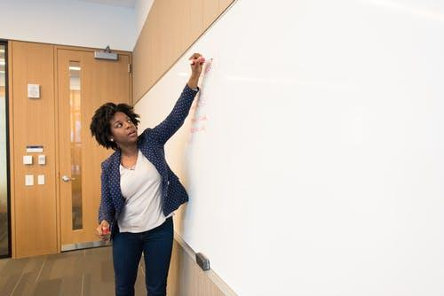
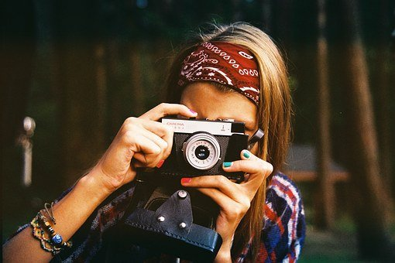

Explore
Look at the following pictures. Can you describe what is shown in each picture?​
Photo on Pexels
Photo by Christina Morillo on Pexels
Photo on Pexels

Slide 5
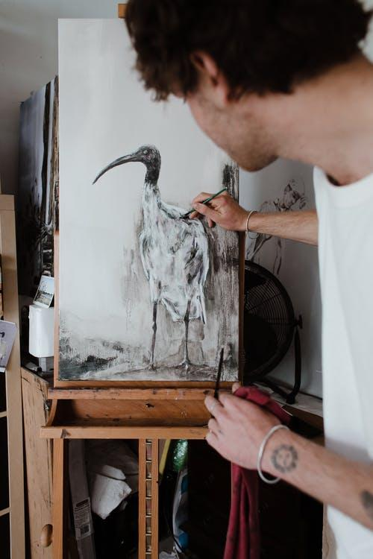

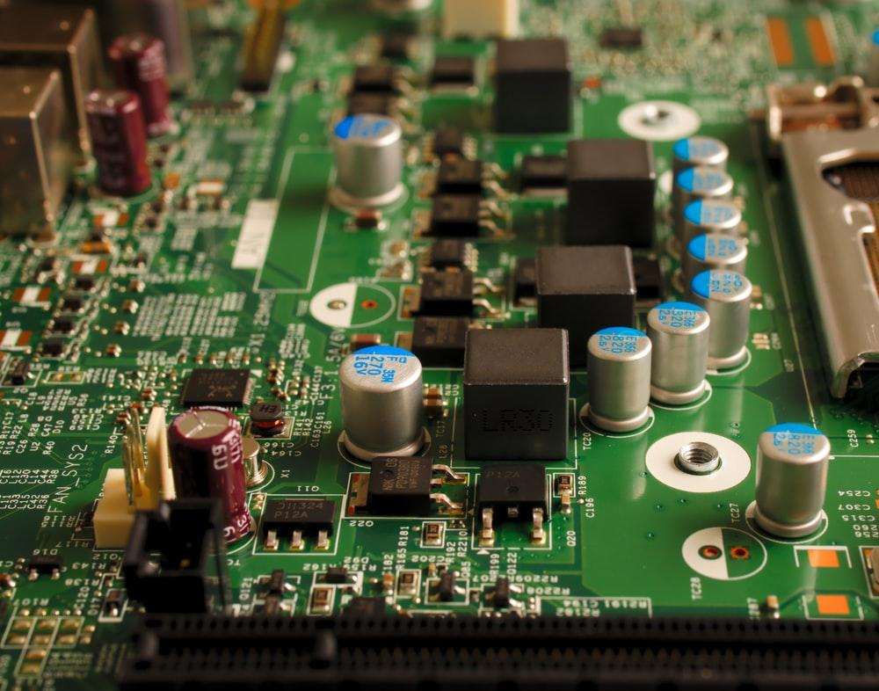
Explore
Look at the following pictures. Can you describe what is shown in each picture?​
Photo by Sora Shimazaki on Pexels
Photo by Rachel Claire on Pexels
Photo by Michael Dziedzic on Unplash

Slide 6
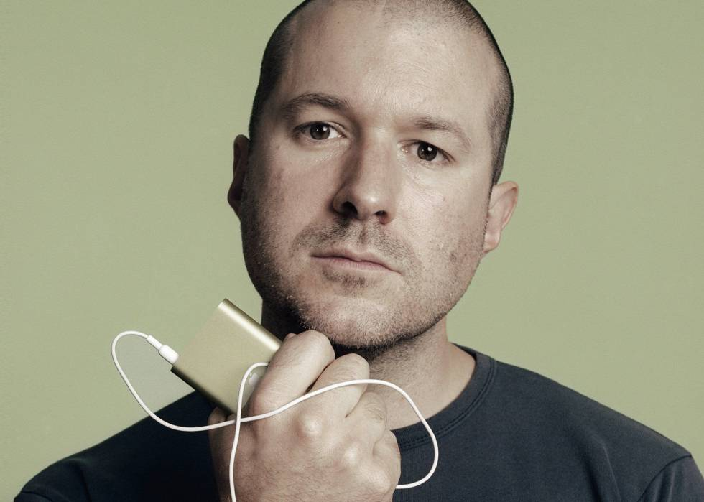
Explore
Read the article A design guru: Jonathan Ive. Pay attention to the words in bold.
A design guru: Jonathan Ive
Sir Jonathan Ive (pronounced /aiv/) is an English designer who is considered one of the most relevant world’s gurus of industrial design. Some of his most stylish and creative works are the iMac, iPod, iPhone and iPad. What makes him so special? He has won many top design awards and he isn’t a common British: He has been honored by Britain’s Queen Elizabeth twice.
Sir Jonathan was born in London in 1967. Design has been important to him since his childhood, but nowadays Ive isn’t only interested in design but also in devices’ power and speed. Ive started working on a project for Apple, the tech giant, in 1992. In 1997, Steve jobs made him Senior Vice President of Industrial Design. Nowadays he isn’t a designer in Apple, but his contribution in terms of technology has been immense. Some people consider him as the “invisible man” (Ive isn’t a public person as he is usually only present via video), but he says the public is interested in the product, people aren’t concerned about the authorship.
Photo on Pexels

Slide 7
Check
Match each of the ideas with the correct ending.
Ive is recognized as a relevant ___
His top design awards aren’t few, they are___
Ive started working for Apple ___
People consider him as ___
He isn’t only interested in design but also ___
in devices’ power and speed.
in 1992.
many.
guru of the industrial design.
the invisible man.
Notes:
Answers: (1-d, 2-c, 3-b, 4-e, 5-a)

Slide 8
Discover
1. Read the following sentences from the text. Write the missing words.
He __________ a common British.
Ive __________ only interested in design but also in devices’ power and speed.
People __________concerned about the authorship.
2. Look at the sentences from the previous exercise. Select T for true or F for false for each statement below.
Add the word not before the verb to be (is – are). T F
Use the apostrophe (‘) to join the verb to be and the word not T F
Notes:
Answers: 1. a. isn’t b. isn’t c. aren’t 2. a.F b. T

Slide 9
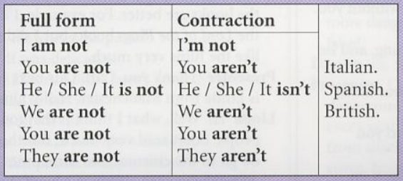
Language focus
Present Tense Verb To Be negative
4
Important
Put not after the verb to make negatives.
You can also contract are not and is not like this:
You are not italian – You aren’t Italian.
She is not Polish – She’s not Polish

Slide 10
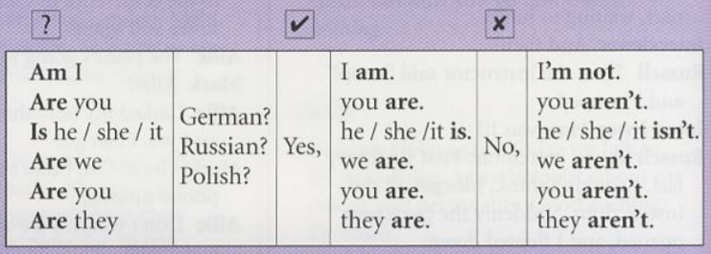
Language focus
Present Tense Verb To Be questions
4
Important
In questions, put be before you, he, etc.
Are you Spanish? NOT You are Spanish.
Where are you from? NOT Where you are from?
Do not use contractions in affirmative short answers.
Are you Scottish? Yes, I am. NOT Yes, I’m.

Slide 11
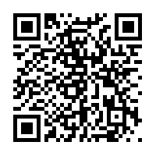

Are you good at geography?
4
Scan the following code and answer the questions!
People Search illustration made by Storyset: <a href="https://storyset.com/people">Illustration by Freepik Storyset</a>
Notes:
https://wordwall.net/es/resource/2640484/you-good-geography

Slide 12

Practice
4
Fill in the blanks with the correct verb to be (affirmative, negative):
a) Sandra isn’t from Spain. She ___________ from Mexico.
b) You ___________ Hungarian. You are Italian.
c) My favorite video game is Tetris. It ___________ League of Legends.
d) I am British. I ___________ French.
e) We aren’t architects. We ___________ programmers.
f) I ___________ an engineer. I’m not a teacher.
g) Felipe’s sixteen years old. He ___________ sixty years old.
h) They aren’t from Egypt. They ___________ from Brazil.
i) Marco ___________ from Mexico. He’s from Japan.
World Isometric illustration made by Storyset: https://storyset.com/illustration/world/amico
Notes:
Complete the sentences with verb to be present (+/-)

Slide 13



Practice
4
Why do countries have flags? Flags show that we belong to a community, organization or nation and that we share beliefs, goals, rules and regulations. Flags are national symbols. Every country has got a specific flag as their national symbol. Take a look at the following flags and join each one with the country that corresponds.
Do you remember Jonathan Ive? Where is he from?
United States
England
Canada

Slide 14

There are different ways in which we can ask what is the country of a person. Take a look at the examples:
Practice
4
Questions
Answers
Ive, where are you from?
I am from England.
Ive, where do you come from?
I’m British
Ive, what is your nationality?
I’m British.
Nationality
Consulting Flat Illustration made by Storyset: https://storyset.com/illustration/consulting/rafiki

Slide 15


Practice
Where’s the stress? Listen and identify the stressed syllable. Listen and repeat.
4
COUNTRIES
NATIONALITIES
England
Scotland
Ireland
Italy
Spain
Holand
Georgia
France
English
Scottish
Irish
Italian
Spanish
Dutch
Georgian
French
Podcast Cartoon illustration made by Storyset: https://storyset.com/illustration/podcast/bro
Notes:
Show students the difference in the stress. Pay attention to syllables in English

Slide 16
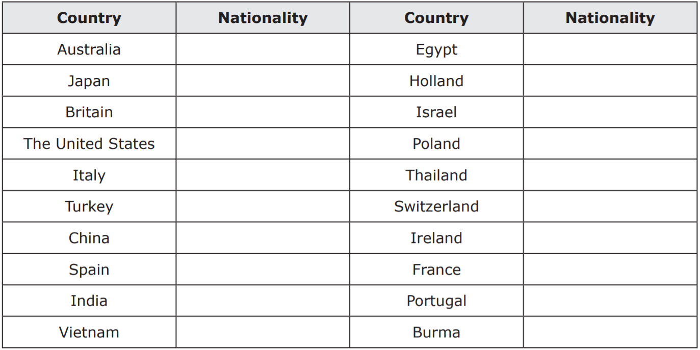
Countries and Nationalities – Understand their suffixes: Read the countries, practice their pronunciation and then write down the nationality of each country.
4
Notes:
Use the “Annotate” tool in Zoom to write students’ responses.

Slide 17
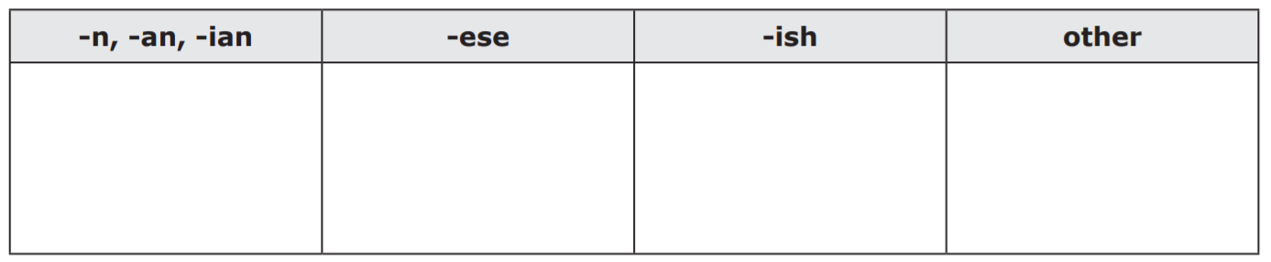
4
Countries and Nationalities – Understand their suffixes: Now, categorize the nationalities according to their suffixes.
Notes:
Show students the difference in the stress. Pay attention to syllables in English. Use the “Annotate” tool in Zoom to write students’ responses.

Slide 18
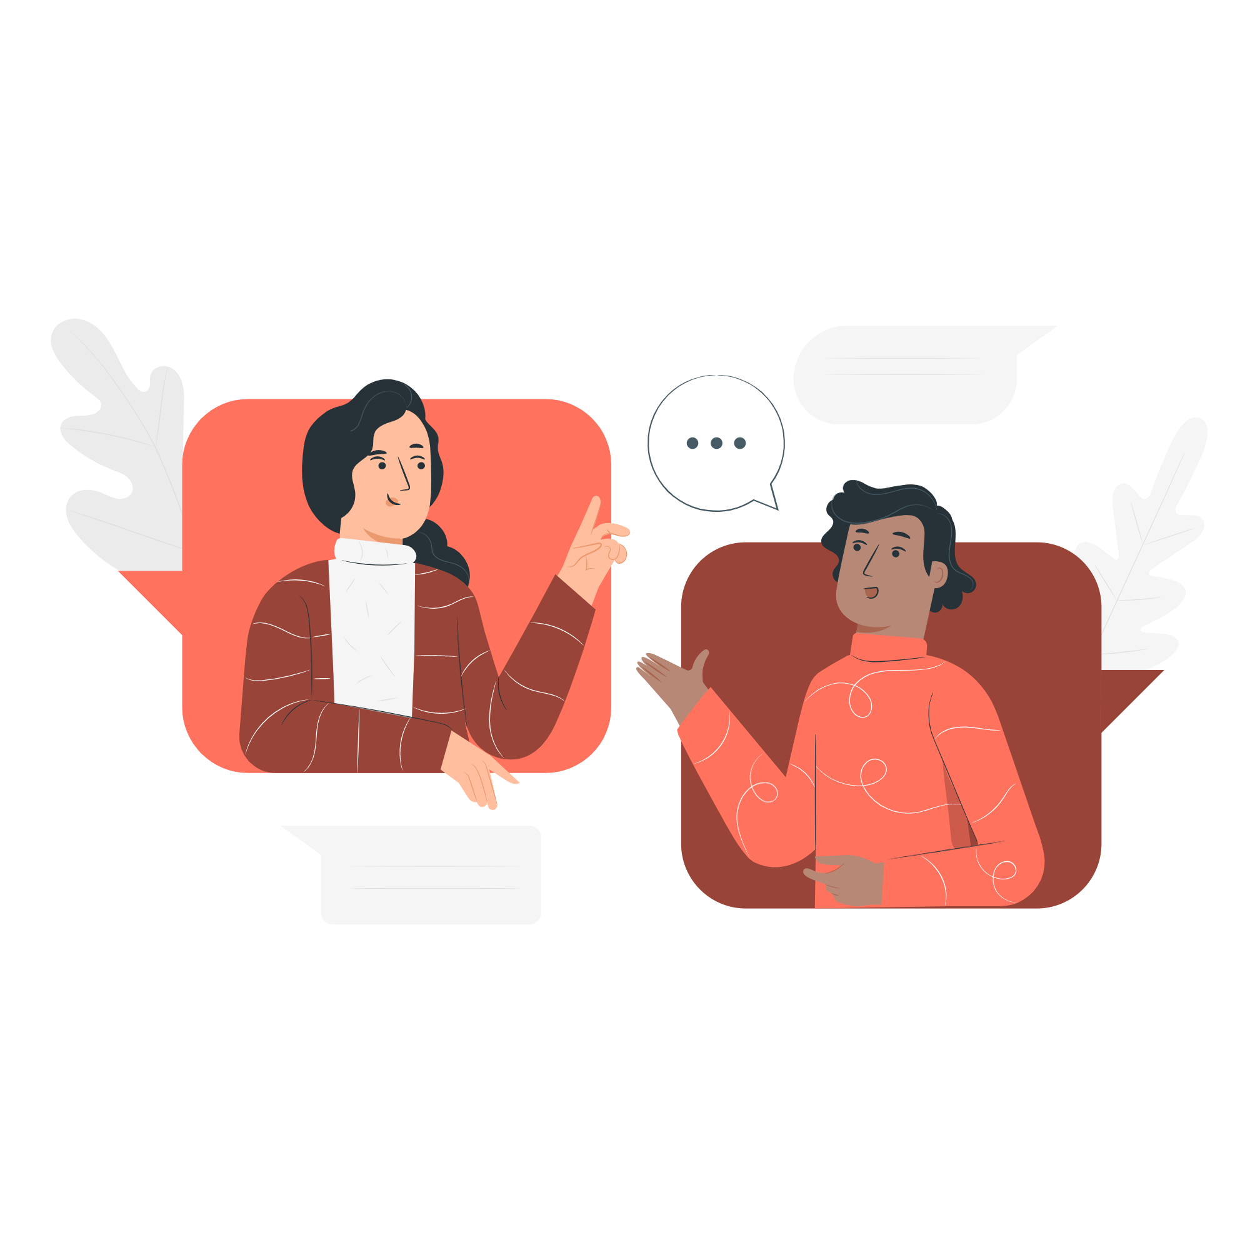
4
Conversation Semi Flat Illustrations made by Storyset: https://storyset.com/illustration/conversation/pana
Work with a partner. Test your partner on the different countries and nationalities. If you say a country, your partner replies with the nationality. If you say a nationality, your partner replies with the country.
Notes:
Show students the difference in the stress. Pay attention to syllables in English

Slide 19
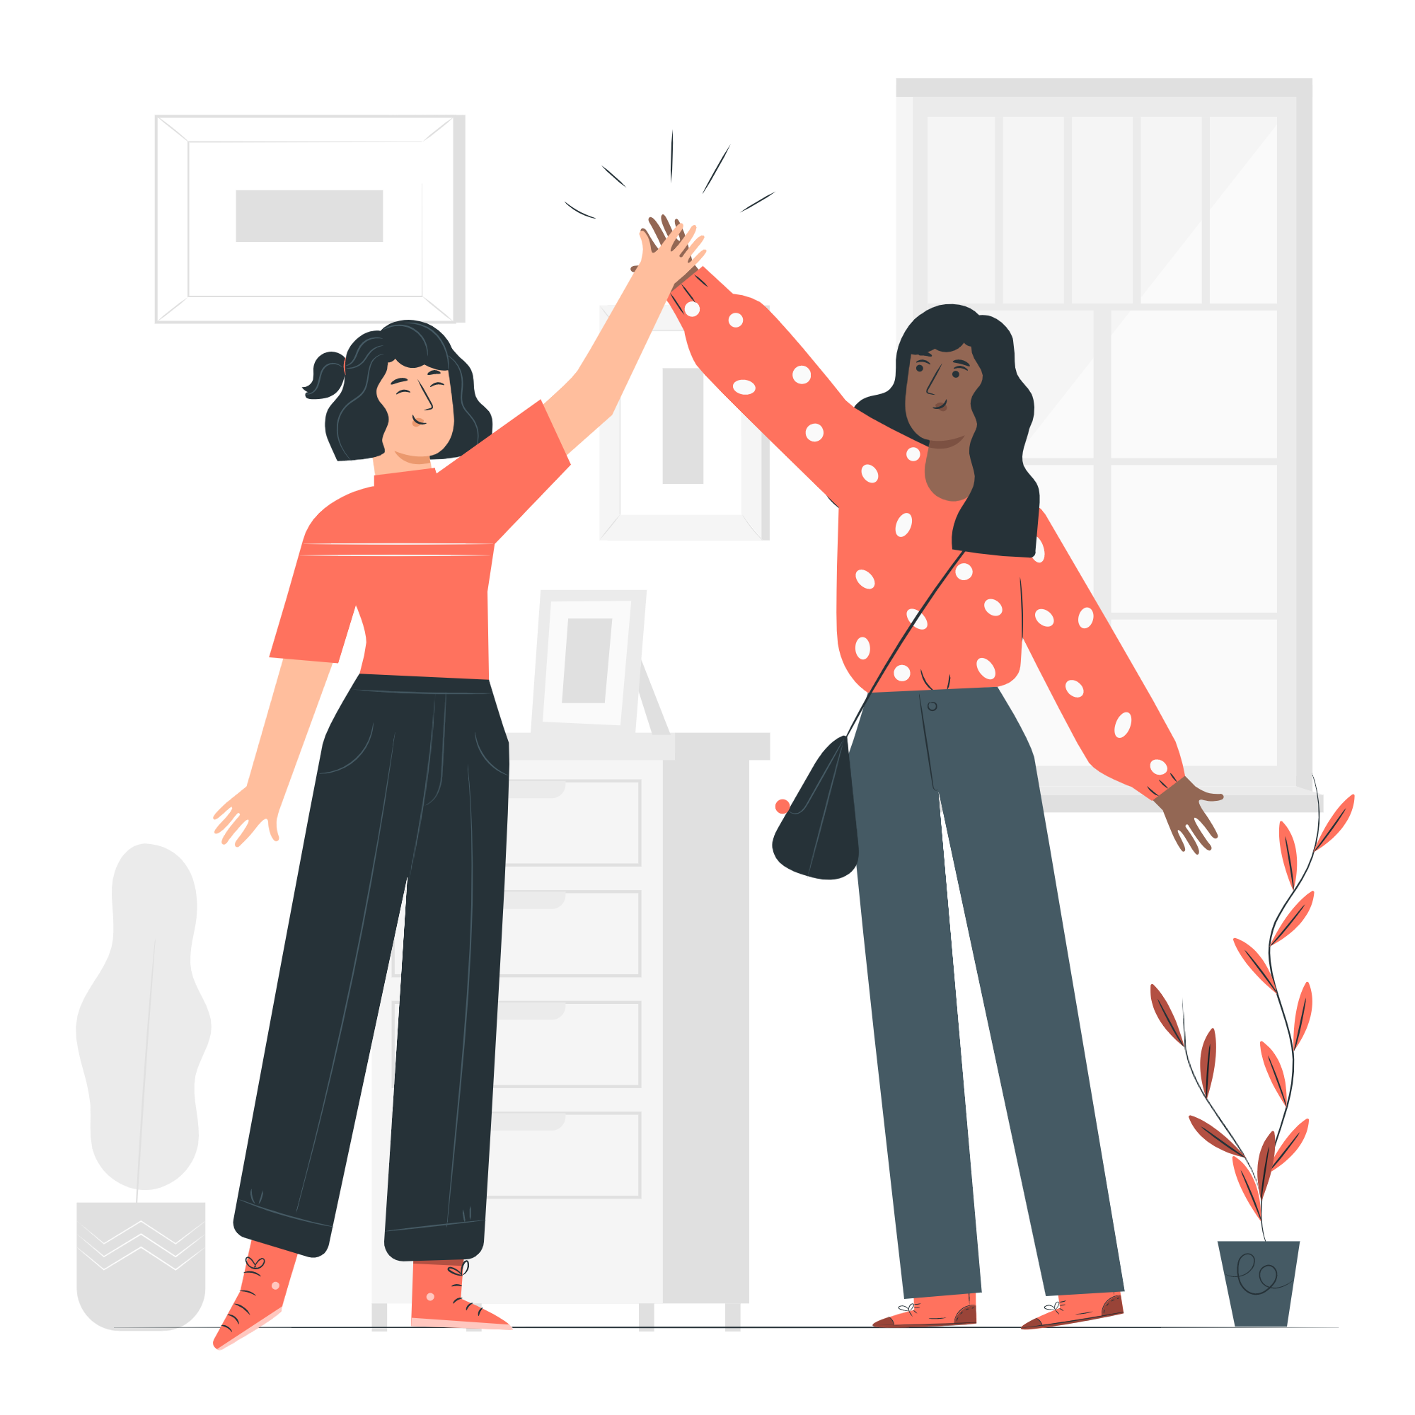
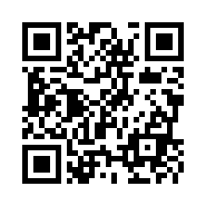
Let’s practice in groups!
4
Now that you have practiced countries and nationalities, you will work with your groups.
Instructions:
Step 0: Open the link given or scan the QR code.
Step 1: One person shares the screen so every student can see the image and countries presented in the exercise.
Step 2: Click on the “i” symbol and listen to the pronunciation of each of the countries.
Step 3: Organize the images with the correct country.
Step 4: Select three countries from the exercise and research three interesting facts and/or curious facts about each one (use verb to be).
Step 5: Be ready to show your findings to the group
Friendship Semi Flat Illustrations made by Storyset: https://storyset.com/illustration/friendship/pana
You have 25 minutes to work in your groups.
Notes:
https://learningapps.org/2059761

Slide 20


Now, it is your time to shine!
Now that you finished working with your group, we will select randomly the group that starts, Each group has four minutes to share as much information as possible
Are you ready?
Let’s go!
Online friends Isometric Illustrations m ade by Storyset: <a href="https://storyset.com/online">Illustration by Freepik Storyset</a>
Notes:
Se puede crear una ruleta con números con el fin de seleccionar el grupo al azar. Página sugerida https://www.online-stopwatch.com/random-name-pickers/name-picker-wheel/?r=dice

Slide 21
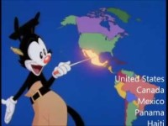
One activity to finish?
Singing is a good way to learn some of the countries. Pay attention to the pronunciation and stress. Which are the most difficult ones to pronounce?

Slide 22
Autonomous
Asynchronous work
MasterTech Platform: My learning Menu 2
1 Appetizers
Whole Main Course
1 Dessert
Bring your questions next class!

Slide 23
See you in your net class when you will learn about:
IT Vocabulary
Imperatives
The alphabet and acronyms

Slide 24
Thank you!

Slide 25
Referencias
Countries and Nationalities: Teach-this.com, 2018. Permission granted to reproduce for classroom use.
Fuente: Imagen tomada de la pagina web de la Universidad Sergio Arboleda

